Slide 1
NYU 6463 PROCESSOR
BY:
DAN WU
KUSH AGARWAL
MADHUMITA SAWANT
MONICA REDDY TIRUPARI
SHUBHAM MAHALANK
XINMEI JIN
ZHAOXI CHEN

Slide 2
PROJECT MILESTONES:
Block Diagram
VHDL code of the complete processor and its individual components.
Functional Simulation of Individual modules.
Functional Simulation of the complete integrated Processor.
Simulation of the two sample codes provided.
RC5 code in assembly.
RC5 assembly code to machine code using the processor’s ISA.
Timing Simulation of the Integrated Processor.

Slide 3
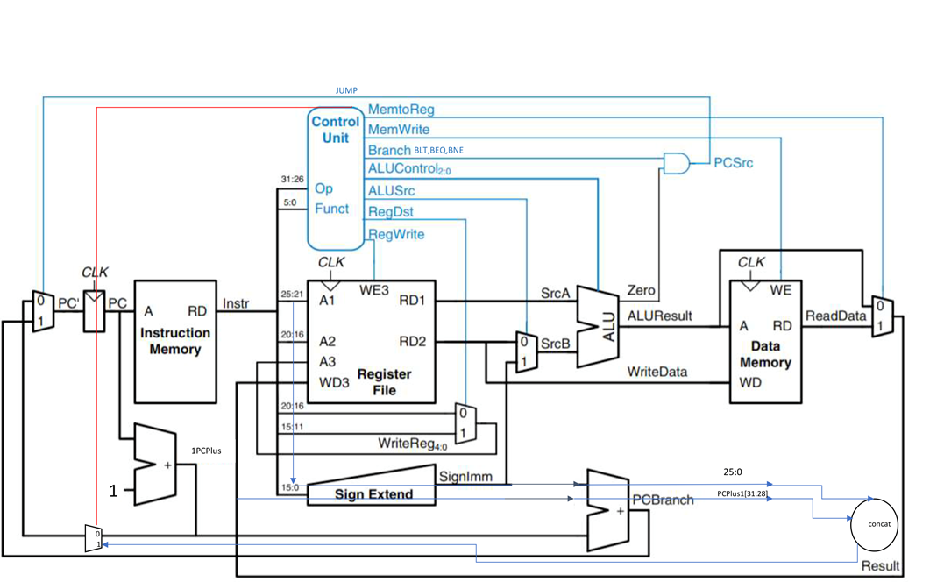
BLOCK DIAGRAM:

Slide 4
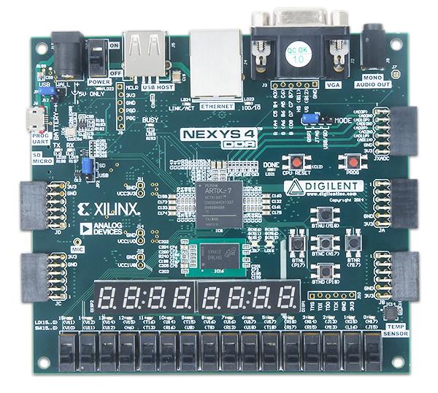
Design:
bit choose
clr
enc
dec
show dout
key_in
Inputs

Slide 5
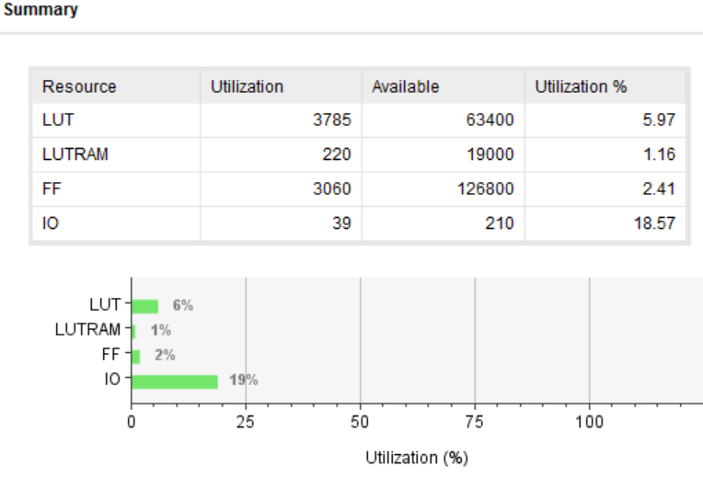
Performance Analysis: LUTs
LUT : 6%

Slide 6
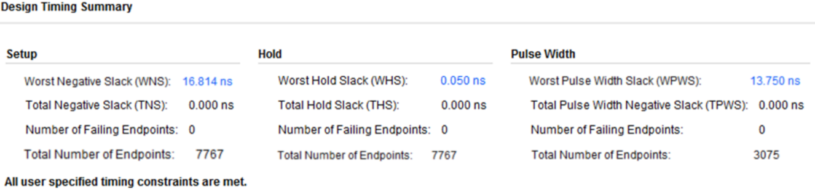
Performance Analysis
Critical path delay: 16.814 ns.
Max frequency of operation: 159.083MHz.

Slide 7
Performance Analysis: RC5
 | Encryption | Decryption | Key Expansion | Total Operation
Clock Cycles | 1248 | 1272 | 5442 | 7962

Slide 8
Project Demo with Test Vector
ukey: 0000ee88 12000043 00055001 0022ee88
din: 1234ffff ffff5678

